Slide 1


COMP90049 Knowledge Technologies
Rule Based Classification and Random Forests (Lecture Set 6)
Rao Kotagiri
School of Computing and Information Systems
The Melbourne School of Engineering
Some of slides are derived from Prof Vipin Kumar and modified, http://www-users.cs.umn.edu/~kumar/

Slide 2
Rule based classification
We need labelled data to build a classifier
Headache | Cough | Temperature | Sore | Diagnosis
severe | mild | high | yes | Flu
no | severe | normal | yes | Cold
mild | mild | normal | yes | Flu
mild | no | normal | no | cold
severe | severe | normal | yes | Flu

Slide 3
Rule based classification
Patient# | Headache | Cough | Temperature | Sore | Diagnosis
p1 | severe | mild | high | yes | Flu
P2 | no | severe | normal | yes | Cold
P3 | mild | mild | normal | yes | Flu
P4 | mild | no | normal | no | cold
p5 | severe | severe | normal | yes | Flu
One good approach is
Construct a decision tree
Extract one rule for each leaf node
Example:
  Rule1: if (headache = severe) then it is Flu
  Rule2: if (headache = mild) and (Sore = yes) then it is Flu
  Rule3: if (headache = mild) and (Sore = no) then it is Cold
  Rule4: if (headache = no) then it is Cold
Headache
severe
No
mild
P1, p5
Flu: 2
Cold:0
Sore
P2
Flu: 0
Cold:1
Yes
No
P3 Flu:1 Cold:0
P4 Flu:0 Cold:1

Slide 4
Rule based classification
Headache
Advantages of Rule synthesis based on Decision Tress are
  All rules are mutually exclusive this implies only one rule will be applicable at the time of decision making
  Easy to extract the rules from traversing the decision tree
Disadvantages
  Too restrictive in terms of number rules learned
  The rules may be too specific and can be very complex
There are many other schemes proposed in the literature and we cover them in the topic of frequent pattern mining.
severe
mild
No
P1, p5
Flu: 2
Cold:0
Sore
P2
Flu: 0
Cold:1
Yes
No
P3 Flu:1 Cold:0
P4 Flu:0 Cold:1

Slide 5
Variants of Decision Trees
Patient# | A1 | A2 | A3 | A4 | Diagnosis
p1 | a11 | a21 | a31 | a41 | c1
P2 | a12 | a22 | a32 | a42 | c1
P3 | a13 | a23 | a33 | a43 | c2
P4 | a14 | a24 | a34 | a44 | c1
p5 | a15 | a25 | a35 | a45 | c2
Issue: Decision Trees cannot capture full information available in the data. This is especially true for data sets with very large number of dimensions.
A solution: Bagging -- build several Decision Trees by sampling the data. For example, for a data set containing N records we sample N records randomly with replacement.
On average each sample will have (2/3) of the N original records. For each sample we build a decision Tree.
We may build say 20-50 such trees.
A3
A3
A4
A1
A2
A1
A2
A2
A4
A4

Slide 6
Variants of Decision Trees
Patient# | A1 | A2 | A3 | A4 | Diagnosis
p1 | a11 | a21 | a31 | a41 | c1
P2 | a12 | a22 | a32 | a42 | c1
P3 | a13 | a23 | a33 | a43 | c2
P4 | a14 | a24 | a34 | a44 | c1
p5 | a15 | a25 | a35 | a45 | c2
We may build say 20-50 such trees.
At the time of classification we collect all the decisions from the decision trees and apply majority rule to make the final decision.
Generally this method works well.
A3
A3
A4
A1
A2
A1
A2
A2
A4
A4

Slide 7
Variants of Decision Trees
Random Forests : This method is similar to bagging in many respects but the construction of each tree is different to the standard decision tree method.
At each node we first randomly select “m” features (attributes) out of all the features unlike the standard method which considers all the non-chosen features so far and chooses the best attribute to split the node among these attributes.
Unlike standard Decision Tree method, there is no need to prune (to reduce the size of the tree) the constructed trees due to the randomness imposed both on the selection of data and the tree construction.
Random Forests are shown to be one of the best classification methods experimentally.
Random Forests can make use of large number attributes unlike standard decision trees.

Slide 8
Variants of Decision Trees
The best performance is obtained for Random Forests when the trees are not correlated to each other (largely independent of each other). That is the overlap of splitting attributes between any two trees is small.
We are able to make the trees random and less correlated:
  by choosing randomly N records with replacement.
  selecting the best attribute for splitting from randomly chosen “m” attributes for each splitting node.
The quality of a decision tree depends on its accuracy which means large m value.
Notes:
N has to be chosen carefully.
N should be large when more accurate.

Slide 9
Variants of Decision Trees
The independence of each tree depends on the small values of m (smaller m means the chosen splitting variable at each node is more likely different to other trees.
Overall quality of the Random Forest depends on both accuracy of the trees and their independence. This implies there must be some optimal values for m which can be determined for example experimentally.

Slide 10
Variants of Decision Trees
Patient# | A1 | A2 | A3 | A4 | Diagnosis
p1 | a11 | a21 | a31 | a41 | c1
P2 | a12 | a22 | a32 | a42 | c1
P3 | a13 | a23 | a33 | a43 | c2
P4 | a14 | a24 | a34 | a44 | c1
p5 | a15 | a25 | a35 | a45 | c2
A3
A3
A4
A1
In the example we have 4 trees.
Each tree is largely different to each other.
This implies the decision errors are not correlated and the overall system should give us the best accuracy possible.
A2
A1
A2
A2
A4
A4

Slide 11
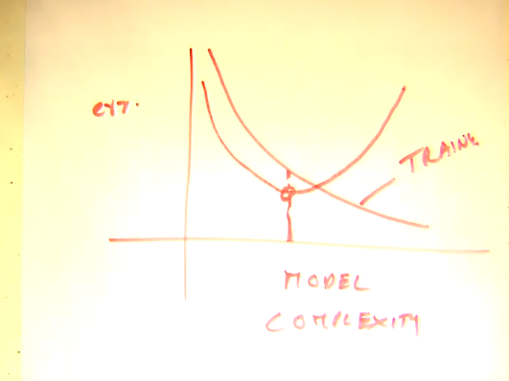
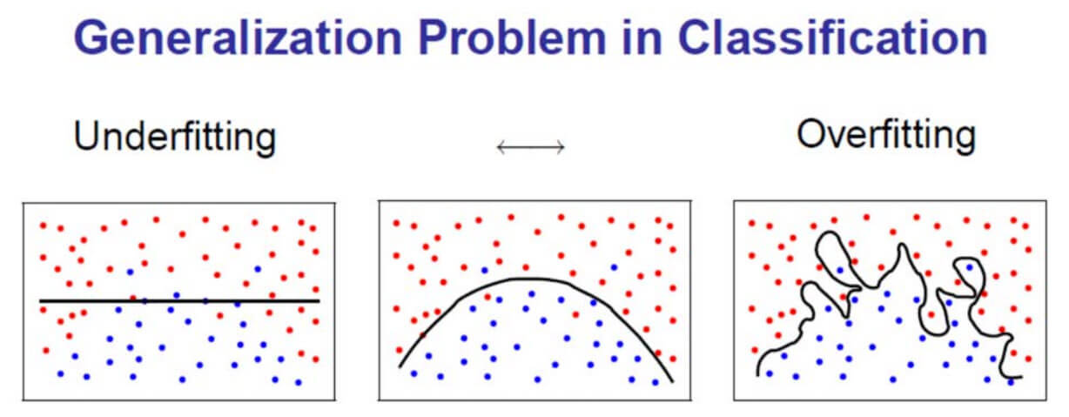
Practical Issues of Classification
Underfitting and Overfitting:
For decision trees, we need to make sure it does not overfit the data.
One way to do this is to have a stopping criterion that makes sure that if the GINI index is smaller than some threshold value we stop splitting the node.
Build the tree completely such that no further splitting is possible. That is either the node is pure (contains one class) or all the attribute values identical (data is inconsistent – records having identical feature values are labeled differently). Once the tree is built we start pruning the tree using some statistical significance test – that is improvement in accuracy is significant.
Notes:
Understand what is underfitting and overfitting
Be careful to find the best word complexity
For training , model doesn’t know what is noise

Slide 12
Practical Issues of Classification
Patient# | A1 | A2 | A3 | A4 | Diagnosis
p7 | a11 | ? | a31 | ? | c1
Missing Values:
  Missing values can be predicated by using the distribution of the attribute values. Especially if we find two highly correlated attributes we can use this correlation to predict the missing value.
Costs of Classification:
  We need to optimize the decision based on cost involved using confusion matrix

Slide 13
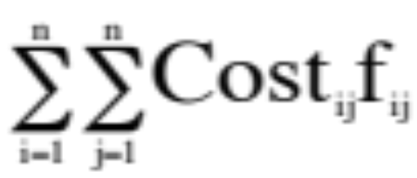
Practical Issues of Classification
 |  | Actual class
 |  | C1 | C2 | … | Cn
Predicted class | C1 | Cost11 | Cost21 | … | Costn1
 | C2 | Cost12 | Cost22 | … | Costn2
 | … | … | … | …
 | Cn | Cost1n | Cost2n | … | Costnn
Costs of Classification:
We need to optimize the decision based on
cost involved using the confusion matrix
Assuming cost Cost_{ij} >=0 the cost of classifying Class i as class j and f_{ij} is the frequency class I is classified as class j.
We need to build the decision system that minimizes the function:
Confusion Matrix |  | Actual class
 |  | C1 | C2 | … | Cn
Predicted class | C1 | f11 | ft21 | … | fn1
 | C2 | f12 | f22 | … | ftn2
 | … | … | … | …
 | Cn | f1n | f2n | … | fnn

Slide 14
Binary Classification
Confusion Matrix |  | Actual class
 |  | T | F
Predicted class | T | TP | FP
 | F | FN | TN
Confusion Matrix |  | Predicted class
 |  | T | F
Actual class | T | TP | FN
 | F | FP | TN
Notes:
Pay attention: transpose.

